Slide 1


Predict Customer Personality to boost marketing campaign by using Machine Learning
Created by:
Fairuz Nur Indah Putri
fnputri31@gmail.com
https://www.linkedin.com/in/fairuz-nur-indah-p/
An Engineering Graduate that highly motivated about learning new things to improve my skills, especially in machine learning, quantitative analytics, and statistics. I am currently interested in working in the data field, especially being a data scientist. I have experience in using Python, R, and SQL and have several machine learning projects that I have worked on including supervised, unsupervised, product recommendation, forecasting, and deep learning with tensorflow.

Slide 2
Overview
“Sebuah perusahaan dapat berkembang dengan pesat saat mengetahui perilaku customer personality nya, sehingga dapat memberikan layanan serta manfaat lebih baik kepada customers yang berpotensi menjadi loyal customers. Dengan mengolah data historical marketing campaign guna menaikkan performa dan menyasar customers yang tepat agar dapat bertransaksi di platform perusahaan, dari insight data tersebut fokus kita adalah membuat sebuah model prediksi kluster sehingga memudahkan perusahaan dalam membuat keputusan ”

Slide 3
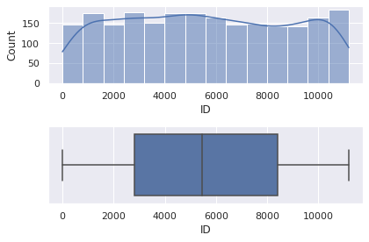
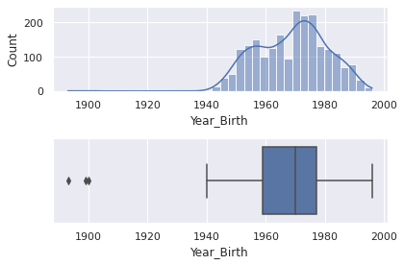
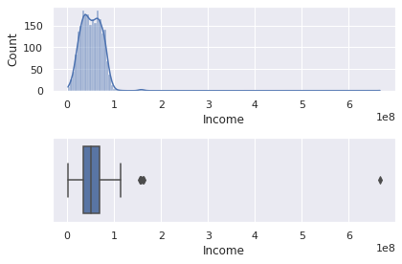
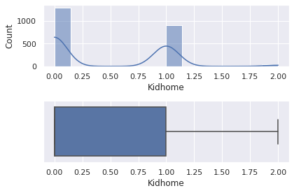

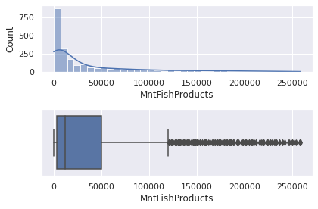
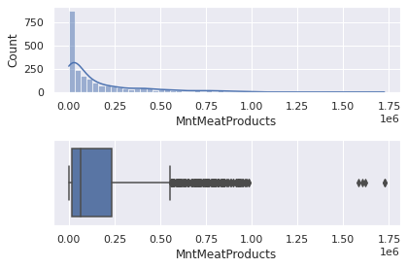
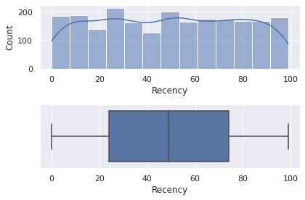
Conversion Rate Analysis Based on Income, Spending and Age
EDA (Numeric Columns)
Untuk selengkapnya, dapat melihat jupyter notebook disini

Slide 4
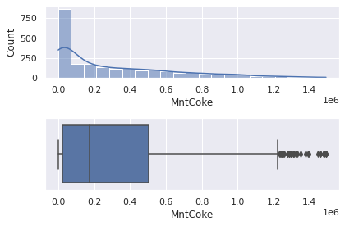
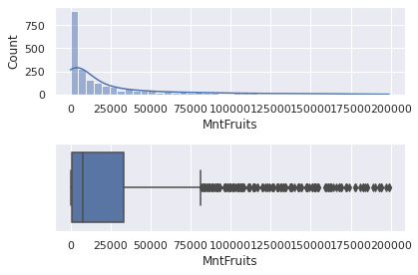
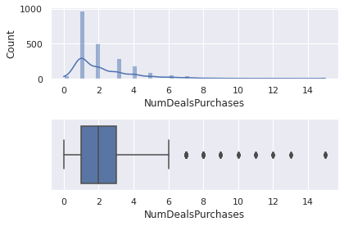
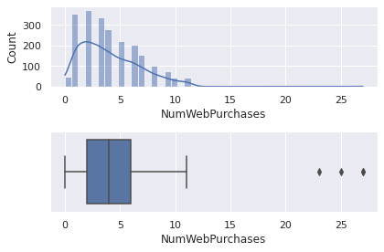
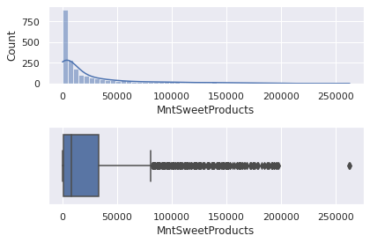
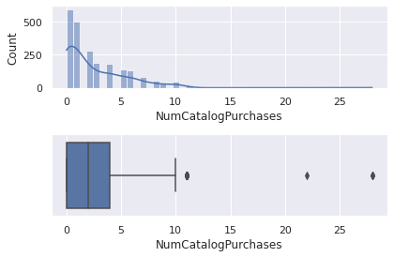
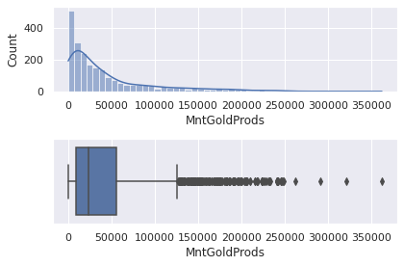
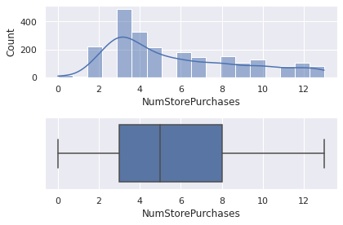
Conversion Rate Analysis Based on Income, Spending and Age
EDA (Numeric Columns)
Untuk selengkapnya, dapat melihat jupyter notebook disini

Slide 5
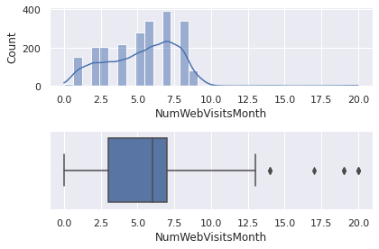
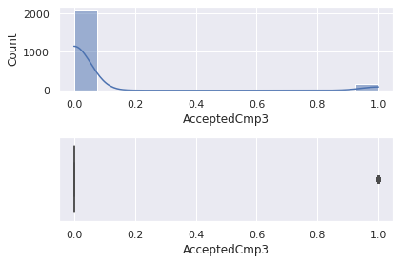



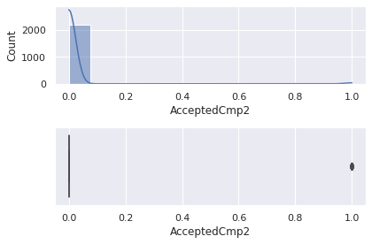
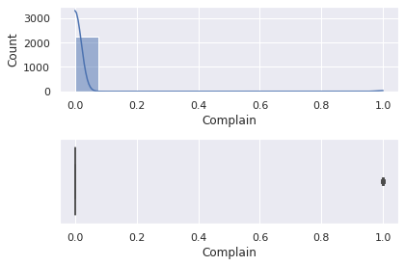
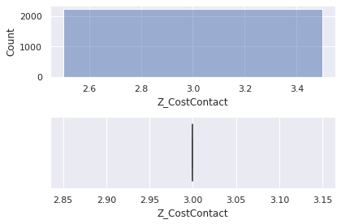
Conversion Rate Analysis Based on Income, Spending and Age
EDA (Numeric Columns)
Untuk selengkapnya, dapat melihat jupyter notebook disini

Slide 6
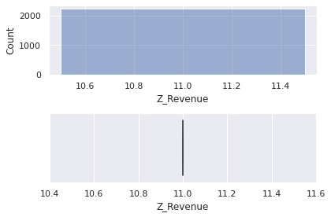
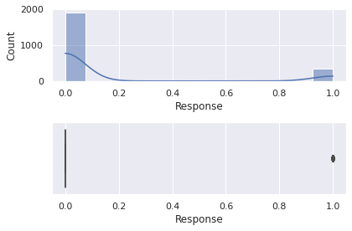
Conversion Rate Analysis Based on Income, Spending and Age
EDA (Numeric Columns)
Untuk selengkapnya, dapat melihat jupyter notebook disini

Slide 7
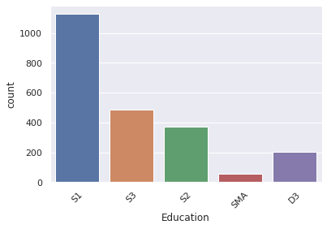
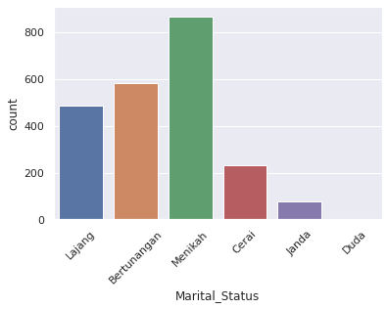
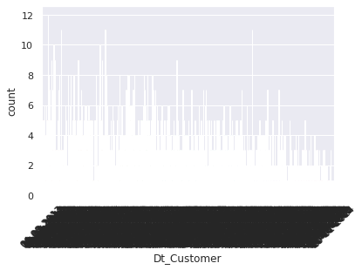
Conversion Rate Analysis Based on Income, Spending and Age
EDA (Category Columns)
Untuk selengkapnya, dapat melihat jupyter notebook disini

Slide 8
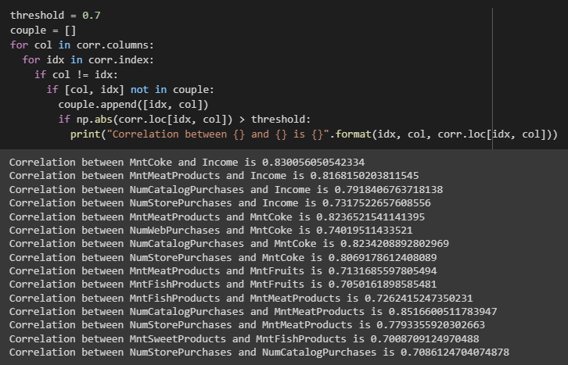
Conversion Rate Analysis Based on Income, Spending and Age
EDA (Correlation)
Untuk selengkapnya, dapat melihat jupyter notebook disini

Slide 9
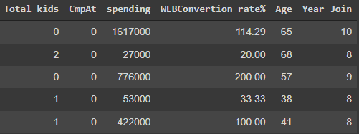
Conversion Rate Analysis Based on Income, Spending and Age
2. Data Preparation
Several columns resulting from feature extraction : Total_kids, spending, WEBConvertion_rate%, Age, Year_Join
Total_kids = Kidhome + Teenhome
cmpAt = customer accepted at which campaign (scale 1 – 5, there are 5 campaign)
spending = MntCoke + MntFruits + MntMeatProducts + MntFishProducts + MntSweetProducts + MntGoldProds
WEBConvertion_rate% = (NumWebPurchases / NumWebVisitsMonth) * 100
Age = date.today().year – Year_Birth
Year_Join = date.today().year - Dt_Customer
Untuk selengkapnya, dapat melihat jupyter notebook disini

Slide 10
Conversion Rate Analysis Based on Income, Spending and Age
2. Data Preparation
Change and merge Janda and Duda value with Cerai
Untuk selengkapnya, dapat melihat jupyter notebook disini

Slide 11
Conversion Rate Analysis Based on Income, Spending and Age
Impute Missing Value – Simple Imputer
Encoding – One Hot Encoding
Scaling – Robust Scaler
3. Feature Engineering
Untuk selengkapnya, dapat melihat jupyter notebook disini

Slide 12
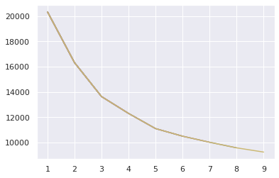
Conversion Rate Analysis Based on Income, Spending and Age
4. Modeling
Elbow Method
Based on elbow method result, we can choose 3 or 5 for the k. I choose 3 for the k because after looking forward through the model k = 3 gives good cluster.
Untuk selengkapnya, dapat melihat jupyter notebook disini

Slide 13
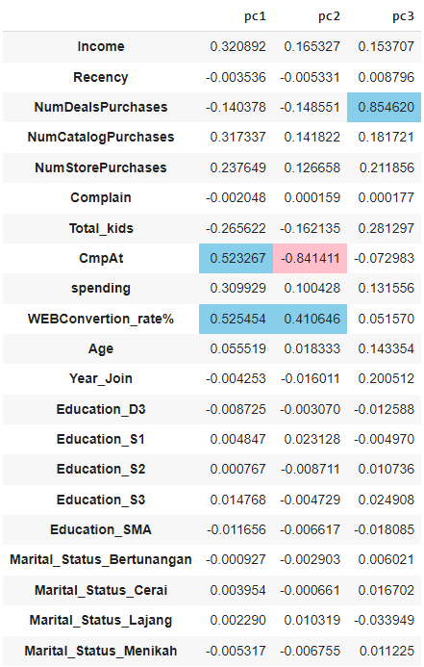
Conversion Rate Analysis Based on Income, Spending and Age
4. Modeling (With PCA)
After fit and transform the model with PCA using data after feature engineering. We can get the pca component with pca.components_, and according to the picture beside we can see all features that more dominant and representative to the PC (have same direction)
CmpAt and WebConvertion_rate% represent pc1 with pca component score 0.523 and 0.524. Choose WebConvertion_rate% because have highest score than CmpAt
CmpAt and WebConvertion_rate% represent pc2 with pca component score -0.841 and 0.416. Choose CmpAt because have highest score than WebConvertion_rate% (minus means different direction).
NumDealsPurchaces represent pc3 with pca component score 0.854.
Untuk selengkapnya, dapat melihat jupyter notebook disini

Slide 14
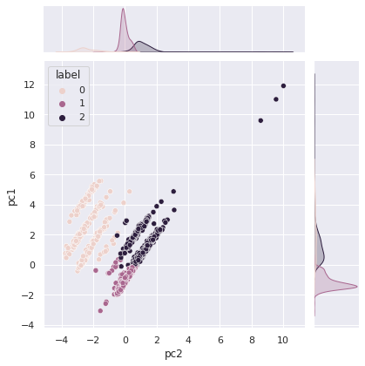
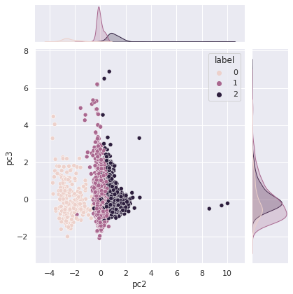
Conversion Rate Analysis Based on Income, Spending and Age
4. Modeling (With PCA)
Clustering result
pc1(WebConversion_rate%): label 1 is distributed in the middle value, label 0 in the low value, and label 2 in the high value.
Pc2(CmpAt):label 0 is distributed in the low value, label 1 is distributed in the high value and label 2 is distributed in the middle value.
In addition, label 2 has a high standard deviation because the distribution is spread when viewed on labels pc1 and pc2.
pc3 (NumDealsPurchaces), it is difficult to do clustering because the data distribution coincides.
Untuk selengkapnya, dapat melihat jupyter notebook disini

Slide 15
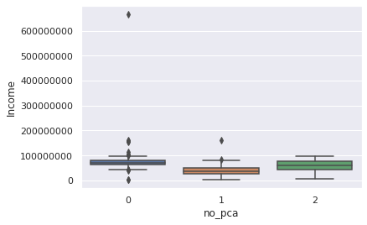
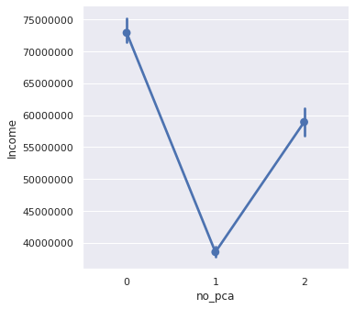
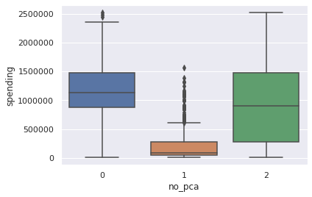
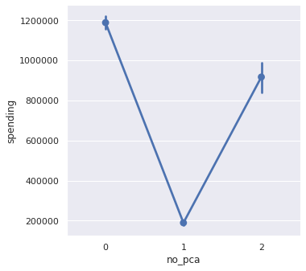
Conversion Rate Analysis Based on Income, Spending and Age
4. Modeling (Without PCA)
Clustering result based on Income, Spending, and Age
For feature spending, it can be seen that label 0 has a higher average value between 1,000,000 million to 1,200,000 million. Label 1 has the lowest average value between 0 - 200,000 thousand, and label 2 has an average value in the middle, which is around 800,000 thousand to 1,000,000 million.
For feature income, it can be seen that label 0 has a higher average value between 70,000,000 million to 75,000,000 million. label 1 has the lowest average value between 0 – 40,000,000 million, and label 2 has an average value in the middle which is around 55,000,000 million to 60,000,000 million.
Untuk selengkapnya, dapat melihat jupyter notebook disini

Slide 16
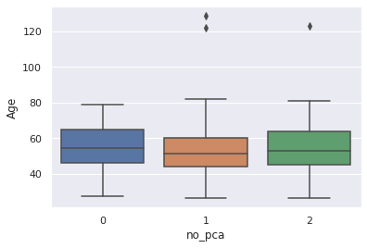
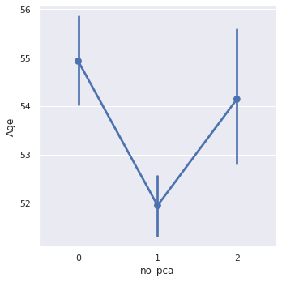
Conversion Rate Analysis Based on Income, Spending and Age
4. Modeling (Without PCA)
Clustering result based on Income, Spending, and Age
For feature Age, it can be seen that label 0 has a higher average age that is 55. Label 1 has the lowest average age that is 52, and label 2 has an average age in the middle, that is 54.
Untuk selengkapnya, dapat melihat jupyter notebook disini

Slide 17
Conversion Rate Analysis Based on Income, Spending and Age
4. Bussines Recomendation
For label 0, because it has a large average income and spending, luxury products can be offered along with discounts
For labels because they have a small average income and spending, we can offer several products that have discounted prices
For label 2 we can offer both those offered on customer label 1 and label 0.
Untuk selengkapnya, dapat melihat jupyter notebook disini

